Slide 1
The Complete ASP.NET, .NET Core MVC & .NET Core Razor Pages Story
David Walker
Sitecore 2018 & 2015 MVP, 3x MS-MVP, Principal Architect – Clear Measure
Notes:
http://www.publicdomainfiles.com/show_file.php?id=13548611416984

Slide 2
Abstract
In this workshop, you will first learn a the history and key components of the ASP.NET MVC platform from beginning to the recently released .NET Core Razor Pages.
Then, dive deep into building advanced web sites with ASP.NET Core MVC and Razor Pages applications. You will learn everything you need to know and more.
This includes many advanced "Digital Strategies" that will help you build web "Experiences" and not just "Sites".

Slide 3





































TITANIUM SPONSORS
Platinum Sponsors
Gold Sponsors

Slide 4
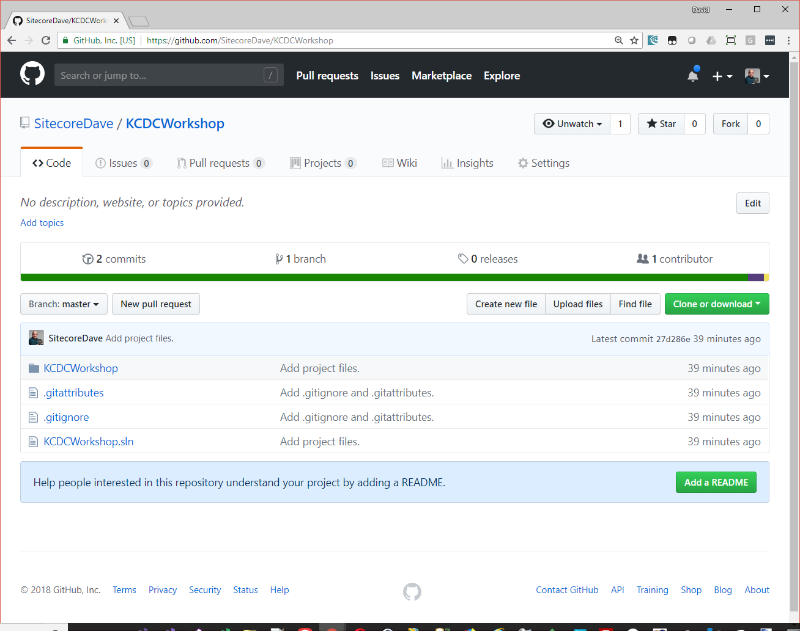
Github.com/SitecoreDave/KCDCWorkshop

Slide 5
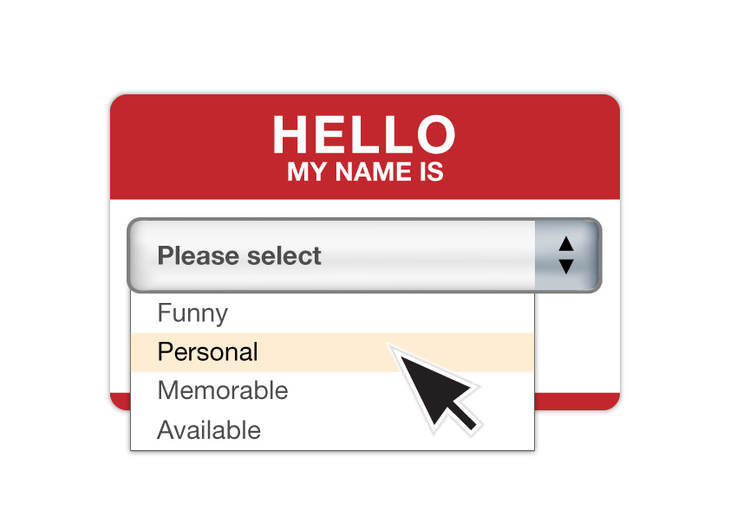

Slide 6
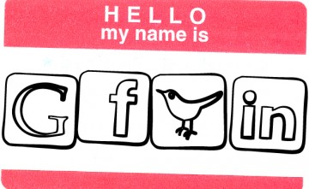
Or kids today…

Slide 7
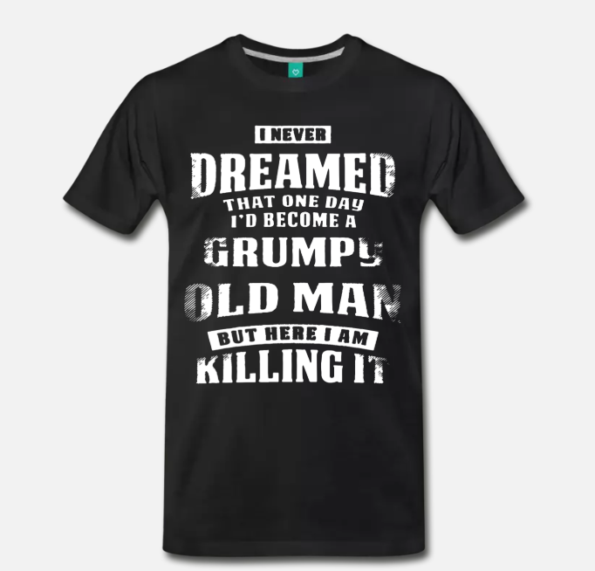
Grumpy Old Man

Slide 8


David Walker
Sitecore 2018 & 2015 Technology MVP
Former three-time Microsoft ASP.NET MVP
Principal Architect – Clear Measure
Sitecore Certified Developer I & II – 5.3 & 8.2
Over 25+ years exp, 75% as a Consultant
Certified Scrum Master, Scrum Developer
MCP in 2003, MCAD & MCSD in 2005
Former Senior App Dev Manager at Microsoft
TechFests.com founder – 13th year of TulsaTechFest.com
SITECOREDAVE.com, RADICALDAVE.com, “Mr. TechFest”
Connect with Me
Email : dave@RadicalDave.com
Twitter : @DavidWalker
Blog: RadicalDave.com

Slide 9
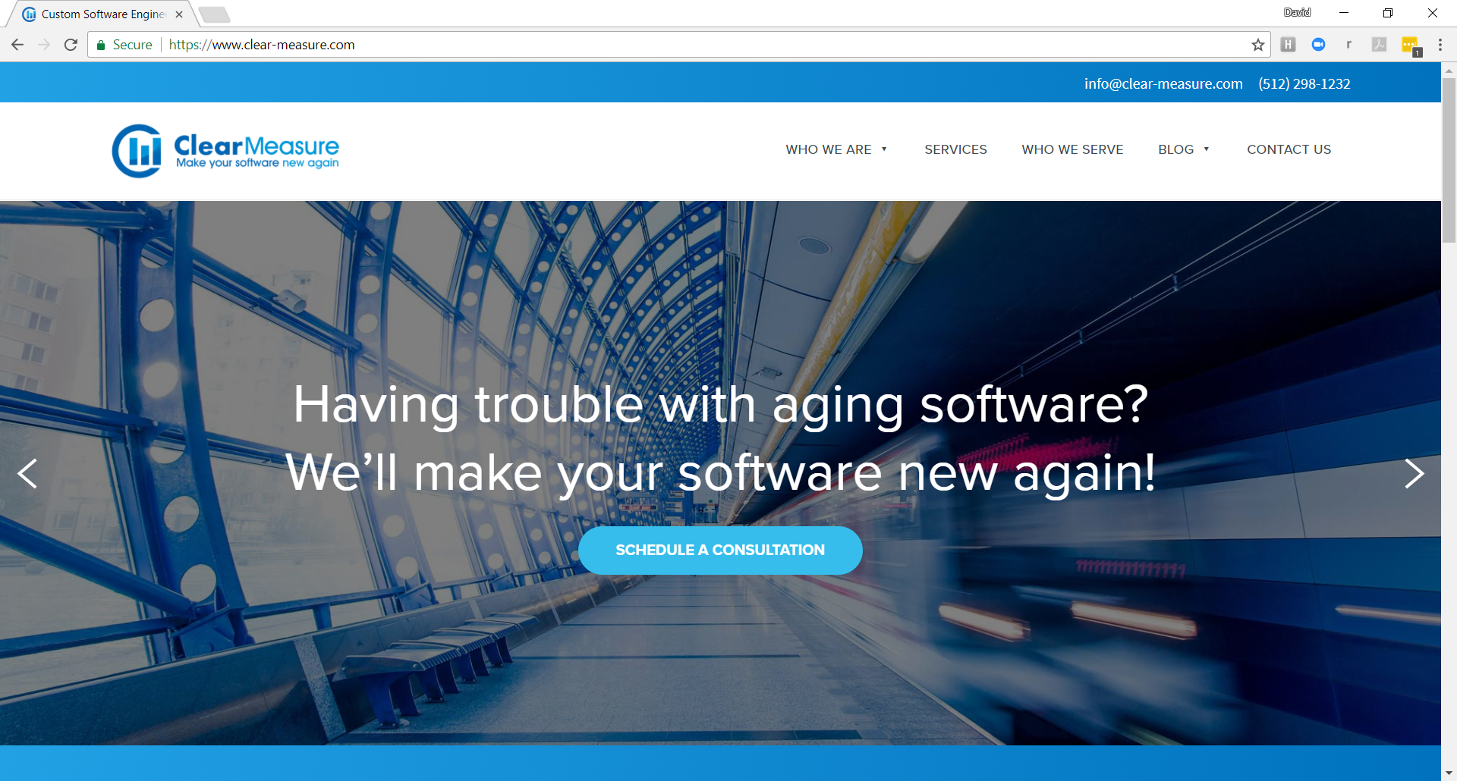
ClearMeasure – Aging Software – New Again
Aging Software – New again

Slide 10

Your house?

Slide 11

Mine! Got .NET…Will travel!

Slide 12

Housekeeping…

Slide 13
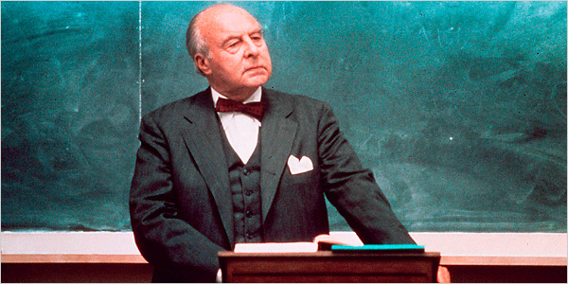
I’m Not a Professor

Slide 14


Slide 15

I’m Not a Politician
But if
I was

Slide 16
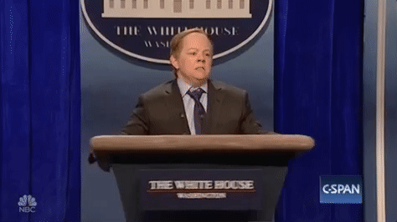

Slide 17


Slide 18
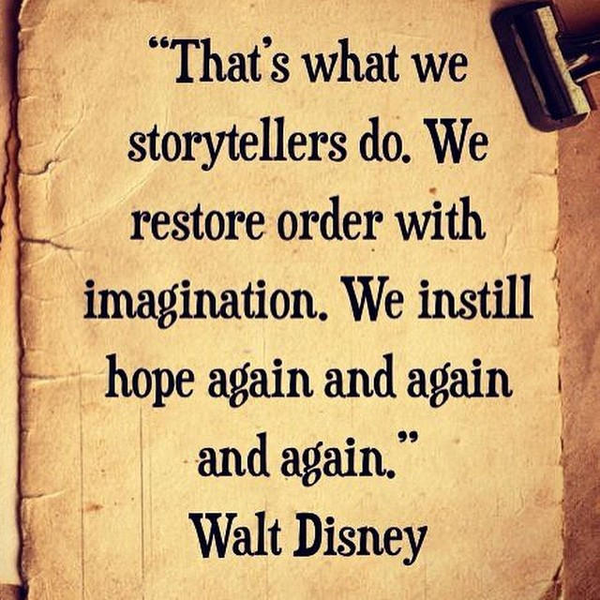
Notes:
Ignorance is bliss?

Slide 19

Notes:
Ignorance is bliss?

Slide 20

Notes:
Ignorance is bliss?

Slide 21

UNLEASHED!
Notes:
Ignorance is bliss?

Slide 22


Slide 23


Slide 24

The Sky is Blue…
and the birds
are singing!
Notes:
Bliss. Ah. Sweet Bliss.. For Customers, Marketing Team and Business

Slide 25
Accelerate Your Journey By Joining Mine
Notes:
Join my on My Journey… and learn from my experience

Slide 26
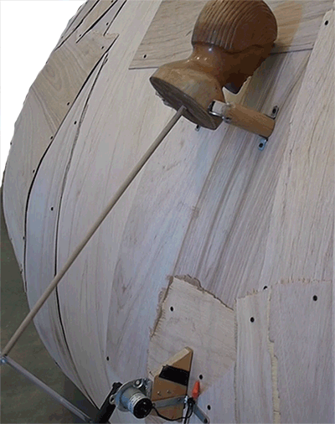
Refactor … yet again
Notes:
With simple Provider style organization, you can exponentially Accelerate the Business Experience

Slide 27

TEAMWORK

Slide 28


Slide 29


Slide 30


Slide 31
REAL WORLD VERSUS HELLO WORLD?
Notes:
Join my on My Journey… and learn from my experience

Slide 32
demo
EPIC!
Notes:
GROUPLINGS.COM – Razor Pages, Azure, jQuery, on and on…

Slide 33
demo
Grouplings.com

Slide 34
Survey says…
How many doing WebForms?
How many doing non-web?
Doing MVC?
Doing MVC only?
Doing Core?
Notes:
The wrong way!

Slide 35
Goals
Keep you from going LOCO
Save you some headaches
Show you the path
Know when to hold ‘em,
Know when to fold ‘em,
Know when to walk away,
Know when to RUN…
Notes:
The wrong way!

Slide 36
Goals - Seriously
Give you the most value… and understanding
Notes:
The wrong way!

Slide 37
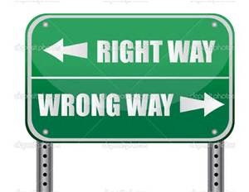
What if it was crystal clear which way to go?

Slide 38
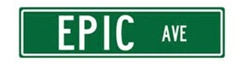
What about the best way to go?

Slide 39

Trying to keep up with Microsoft’s Dev Stack?

Slide 40
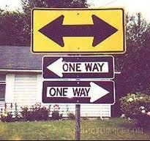
Which way do you go?

Slide 41

Have you integrated MANY systems?

Slide 42
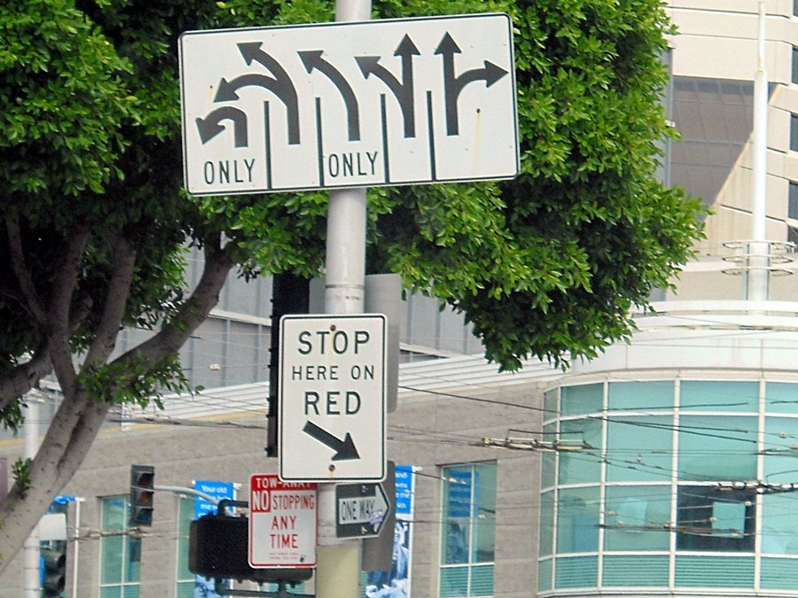
Have you integrated MANY systems?

Slide 43

Are you crazy yet?

Slide 44

You, Your Company, Your Customers Get 3 Wishes
What Would You Wish For? Your Company? Your Customers?

Slide 45

I’m Here, You’re Here… What’s Your Other Two Wishes?
Notes:
For some.. They think this is enough…

Slide 46

You Can Be The Super Hero!

Slide 47

At LEAST A Super Hero
To Your Customers & App Users

Slide 48




Slide 49
Agenda/Goals
Chapter 1 – ASP.NET
Chapter 2 – MVC
Chapter 3 - .NET MVC Core
Chapter 4 – Razor Pages
Resources
Notes:
The wrong way!

Slide 50
Chapter 1 ASP.NET
Notes:
http://www.publicdomainfiles.com/show_file.php?id=13548611416984

Slide 51







How we got here…
Rob Vettor
1996
2002
2009
Notes:
Helps to understand the history of the platform
ASP 1.0 was released on December 1996 as part of IIS 3.0; ASP 2.0 was released on September 1997 as part of IIS 4.0; ASP 3.0 was released on November 2000 as part of IIS 5.0; ASP 2.0 provides six built-in objects: Application, ASPError, Request, Response, Server, and Session.
Before 2002, we built ASP web apps using VBScript and HTML in the old Visual Studio versions
Very easy and popular way to build simple web applications
2002 brought us Visual Studio.NET and ASP.NET
Delivered complete framework for building web-based apps
Brought compiled code and highly-productive tooling to the Microsoft web stack
Extremely popular – to this day
2009 brought us ASP.NET MVC
More granular approach to building web applications
Model View Controller built into the framework

Slide 52
ASP.NET Web Forms
ASP.NET
Released 2002
End-to-end framework for building web-based applications
Stateful programming experience
Abstracts HTTP/Web complexity
Server Controls render HTML
ViewState maintains state between requests
Post-Back architecture encapsulates server round-trips
Widely used and enhanced in subsequent Visual Studio releases
Caching
Modules
Pages
Controls
Profile
Roles
Intrinsics
Handlers
Globalization
Master Pages
Membership
Notes:
Stateful programming abstractions played well to VB6 Windows developers who could now build web apps with minimal knowledge of the internet, HTML and client-side technologies

Slide 53
ASP.NET Web Forms
Benefits
Well understood, stable, mature
Encapsulates complexity
Embraces high productivity
Shortcomings
Weak separation → Code/Markup commingled
Unit testing → Difficult
Server Controls → Limited control over HTML
Page Life-Cycle → Complex and can be problematic
Notes:
Weak Separation
Code and Markup commingled without a clear separation of View, Model and Controller functionality
Unit Testing
Tight-coupling between markup and code makes it difficult to unit test web form apps as testing a web form requires instantiating the Page class which requires an instance of the underlying web forms engine, which pretty much converts your unit test to an integration test
Server Controls
Generates HTML based upon browser and version
Provide minimum control over the way HTML is generated
Each server control executes its own control life-cycle (i.e. set of events) adding overhead to the overall request
Page Life-Cycle
Web Forms implements eventful server-side programming model
Eventing model can become problematic in larger applications

Slide 54
Weak Separation
Comingling of Markup and Code
ASP.NET
Engine
Code-
Behind
Class
Request
.aspx
File
Generated
Page
Class
Response
Final
Class
Can be challenging to test, manage and extend
Notes:
No “clear” separation between Controller, Model and View components
Although the markup code and code-behind in web forms appear to be in separate files, runtime commingles into single class
Workable for smaller applications, but can become problematic in larger, complex business applications

Slide 55

Testing Can Be Difficult
Unit testing individual responsibilities can be challenging
Logic
UI
May have to resort to spinning up entire ASP.NET runtime engine to test
Notes:
Estimated Time: 2 minutes
Talking Points:
Unit testing web forms is HARD, due to the lack of SoC and the fact that web forms is based on a monolithic runtime environment that is not pluggable or flexible.
It is hard to test an ASP.NET page without spinning up the entire runtime.
The bottom line is that the Web Forms platform was not built with testing in mind.

Slide 56
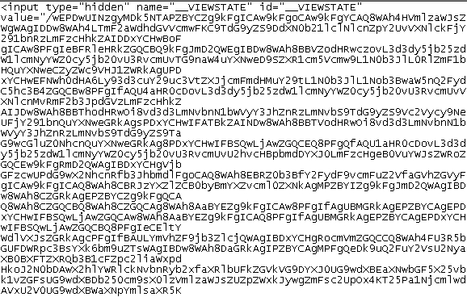

Server Controls
<asp:label id="lblEmail" runat="server“ />
<asp:textbox id="txtEmail" runat="server“ /> <asp:button id="btnSub" runat="server" text="Submit" onclick="btn_Click“ />
Generates HTML elements
Powerful and easy to use
HTML can be verbose and difficult to control
Excessive ViewState can impact performance
Each control is object and adds additional processing overhead
Notes:
Estimated Time: 2 minutes
Talking Points:
Server controls are powerful in that they encapsulate the UI and business logic. You just drag them on a page and go.
They generate HTML for you based upon the browser and version to which you are rendering.
Server controls render HTML themselves, hiding all that complexity, which is great until you need control over the generated HTML.
Another common problem is viewstate
ViewState is mechanism for maintaining state across requests, whereas each control automatically saves its state and sends a Base64 encoded string in a hidden HTML element to the browser.
The problem is that gigantic blocks of data (hundreds of bytes) can be transferred between browser and server on each request, degrading performance, increasing network traffic and page load time.

Slide 57
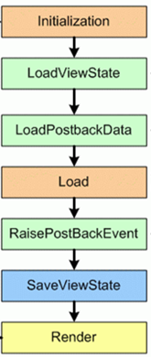
Page Lifecycle
Web Form model implements eventful server-side programming model
Can become problematic in larger applications
Request
Each control raises Init event
Page and controls load view state data
Page and controls load post back data
Page and controls raise Load event
Control that caused postback executes operation
Page and controls save view state data
Response
Each control emits HTML
Notes:
Estimated Time: 2 minutes
Talking Points:
When an ASP.NET page runs, the page goes through a life cycle in which it performs a series of processing steps.
These include initialization, instantiating controls, restoring and maintaining state, running event handler code, and rendering.
In web forms, you need knowledge of the page life cycle, in order to write code at the appropriate stage for the effect you intend. Additionally, if you develop custom controls, you must grasp a deep knowledge of the page life cycle in order to correctly initialize controls, populate control properties with view-state data, and run any control behavior code. The processing steps listed here are a subset of the possible steps available during the lifetime of a request.
This abstraction tries to encapsulate the stateless nature of the web, providing more of a Win-form development experience.
While it simplifies development, especially in abstracting the developer from the world of HTTP, it can become extraordinarily complicated and fragile as the application grows in size.
Trouble shooting page life cycle problems can be time-consuming and frustrating.
Keep in mind the Page Lifecycle is an abstraction created to simplify web development. It is not part of HTTP or the web infrastructure

Slide 58

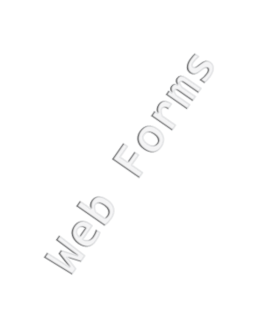
So… Are WebForms are terrible then?
Lets ask the “right” questions:
Do you have any page load performance issues in your existing applications?
Do you see testing as becoming a more important part of your development process?
Do you see Mobile Devices as a target audience for your websites?
Do you have the bandwidth to learn another way of building websites?

Slide 59
Agenda/Goals
Chapter 1 – ASP.NET
Chapter 2 – MVC
Chapter 3 - .NET MVC Core
Chapter 4 – Razor Pages
Resources
Notes:
The wrong way!

Slide 60
Chapter 2 MVC
Notes:
http://www.publicdomainfiles.com/show_file.php?id=13548611416984

Slide 61
What is MVC?
Acronym for Model ● View ● Controller
A design pattern that enforces clear separation between controller, view and model components (SoC)
Controller
Model
Represents compute,
business and data
storage operations
View
Orchestrates operation
Responsible for UI
Notes:
Estimated Time: 2 minutes
Talking Points:
Model-view-controller (MVC) is both a design pattern and an architectural pattern used in software engineering. Successful use of the MVC pattern isolates business logic from user interface considerations, resulting in an application where it is easier to modify either the visual appearance of the application or the underlying business rules without affecting the other.
In MVC, model represents the information (the data) of the application and the business rules used to manipulate the data;
View corresponds to elements of the user interface such as text, checkbox items, and so forth;
Controller manages details involving the communication to the model of user actions such as keystrokes and mouse movements.

Slide 62
What is the ASP.NET MVC?
Full-featured web development framework
Based upon the MVC pattern
Alternate approach for constructing web applications on the Microsoft platform
Does not replace ASP.NET Web Forms
Built on top of the core ASP.NET components
WebForms
ASP.NET
Services
Caching
Routing
Localization
MVC
ASP.NET Core Architecture
Services
Caching
Routing
Localization
Notes:
Estimated Time: 2 minutes
Talking Points:
Model-view-controller (MVC) is both a design pattern and an architectural pattern used in software engineering. Successful use of the MVC pattern isolates business logic from user interface considerations, resulting in an application where it is easier to modify either the visual appearance of the application or the underlying business rules without affecting the other.
In MVC, model represents the information (the data) of the application and the business rules used to manipulate the data;
View corresponds to elements of the user interface such as text, checkbox items, and so forth;
Controller manages details involving the communication to the model of user actions such as keystrokes and mouse movements.

Slide 63

How does MVC Work?
Browser
(5)
(1)
Routing
Engine
(2)
Controller
(4)
View
HTML
Action
(3)
Template that generates UI
Orchestrates operation
Parses incoming URI,
extracts controller
and action name
Service Layer
Repositories
Services
Model
Compute, business and data storage operations
Data
Internet
Notes:
Estimated Time: 4 minutes

Slide 64
Benefits of MVC
Separation of Concerns (SoC)
Each component has single responsbility
Built-in support for TDD, dependency injection, mocking and testability
Performance
No Page/Control Lifecycle, ViewState, PostBacks
Lightweight Views
Full control over HTML
No Code-Behind
Out-of-Band Releases
Release more frequently
Source code available

Slide 65
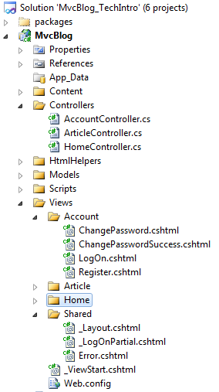
Convention over Configuration
Dictates that specific things are found in specific places with specific naming conventions
Standardizes and simplifies project structure
Increase developer productivity
Controller Suffix
Controllers
Models
Views
Shared Views
Partial views start
with underscore
Notes:
All controllers end with the suffix “Controller,” allowing the framework to register them at startup
Views live in sub-folders with their controller name, relieving developers from having to provide specific locations for each view

Slide 66
MVC Release History
HTML5 Project Template
Mobile Project Templates
Razor View Engine
ASP.NET Web API
First Release
Evolutionary Features
Evolutionary Features
Evolutionary Features
March 2009
ASP.NET
MVC
March 2010
ASP.NET
MVC 2
January 2011
ASP.NET
MVC 3
August 2012
ASP.NET
MVC 4
ASP.NET 3.5 – Core Framework
ASP.NET 4.0 – Core Framework

Slide 67


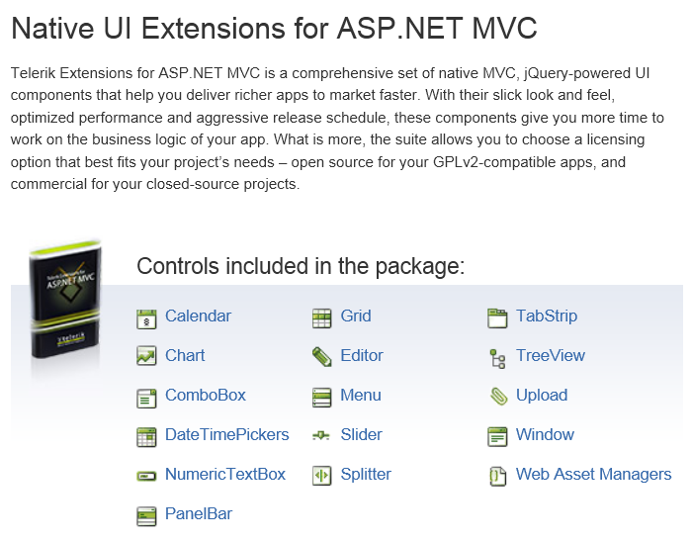
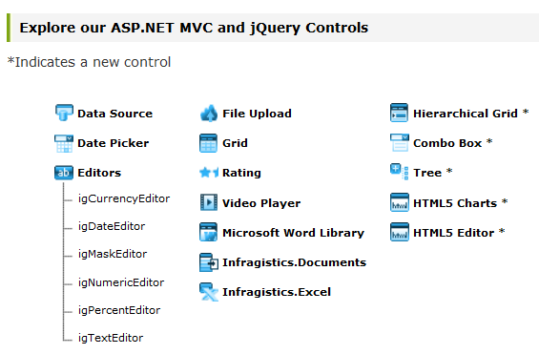
MVC – Community and 3rd Party Products

Slide 68
Choosing Between….
More control over details
WebForms
Control ecosystem
State management
Design time support
MVC
Do it yourself
Stateless
Separation of concerns
Testability
Extensibility++
Ready-to-use building blocks
Notes:
Estimated Time: 2 minutes
Talking Points:
Essentially, WebForms gives you a more abstracted, RAD style. Likely to be easier for devs used to writing windows apps.
MVC gives you less help out of the box, so will need to write more yourself. (Get full control, but have to specify more!). Does have strong extensibility, and was designed with testing in mind.
That said, there are moves in webforms 4.0 to improve some aspects of html generation e.g. Clientids to give more control over output and use of CSS
Equally, MVC 2.0 should bring more in the way of controls.

Slide 69
Chapter 2/Part 2 MVC Deep Dive MODEL
Notes:
http://www.publicdomainfiles.com/show_file.php?id=13548611416984

Slide 70

What is the Model?
Overloaded term -- refers to…
(1) The Service Layers (BAL, DAL, DB) that provide compute,
business and data storage operations
(2) Domain data object returned from operation and passed
to View (presentation model)
Model Layer
Service Layer
Controller
Data
Repositories
Services
Data
Model Object
Presentation Model
Data
Internet
View
Notes:
Estimated Time: 4 minutes
Talking Points:
Model refers to the components that contain business, validation and data access logic
Model also refers to data object to which the View will bind
The bulk of development time will be spent building model functionality

Slide 71
View Models
Recommend approach for injecting data into View
Simple .NET (POCO) class (state only)
Map data class to ViewModel class
Decorate ViewModel with validation/display attributes
Provides layer of indirection –
View not tightly-coupled to service layer
Each can grow independently
Names and types can be different
Contrast with
ViewModel in
MVVM
Decorate with
validation and
display attributes
public class CustomerEntity
{
// Contains 8 data items
}
public class CustomerViewModel
{
// Contain 5 data items
}
Notes:
Estimated Time: 4 minutes
Talking Points:

Slide 72
Lifecycle with ViewModel
Implement map operation manually or with mapping utility tool like AutoMapper
Services
(3)
(4)
Data
(1)
(2)
Controller
Browser
Routing
Engine
(5)
Mapper
Action
(6)
ViewModel
(7)
HTML
View
(8)
Notes:
Estimated Time: 4 minutes

Slide 73
Optional Approach
Loosely-Coupled Model
Controller can pass small amounts of data to View
Assign data in Controller and access in View
ViewData – Dictionary of objects, similar to session state
ViewBag – Dynamic object
ViewData
Name/Value Dictionary
No compile time check
Key Names are strings
Requires casting/boxing
ViewBag
Supports dynamic types
Predefined classes not needed
No compile time check
No IntelliSense
Only supported in .NET 4
Notes:
Estimated Time: 4 minutes
Talking Points:

Slide 74
Chapter 2/Part 2 MVC Deep Dive VIEW
Notes:
http://www.publicdomainfiles.com/show_file.php?id=13548611416984

Slide 75
What is a View?
A template - contains no logic or computations
Single responsibility: Generating HTML
Combines markup/data, generates HTML
@model ArticleViewModel
<h2>Welcome to MVC Blog!</h2>
@foreach (var item in Model.Articles){
<div>
<h3>@item.Title</h3>
<div>
@item.Body
</div>
Posted:
@item.Published.ToLongDateString()
@item.Published.ToShortTimeString()
@item.Author
@item.CommentCount Comments
</div>
}
@model directive: Specifies
strongly-type model file
Mixes HTML and code
Data elements bind to
properties from the model file
Notes:
Estimated Time: 4 minutes
Talking Points:

Slide 76
Views vs. Web Forms
MVC views are passive. No…
Business logic
Server controls
Code-behind
Page-life cycle
Post-backs
Just an HTML template that injects model data where required
Best Practice
Keep business logic and references to objects out of View
Notes:
Estimated Time: 4 minutes
Talking Points:

Slide 77
View Conventions
Views live in sub-folders, beneath the view folder, that correspond to controller names
Each view corresponds to a name of an action method
Views that are shared across controllers live in the shared directory
View names that being with an underscore are partial views and must be called from within a view
Notes:
Estimated Time: 2 minutes
Talking Points:

Slide 78
Chapter 2/Part 3 MVC Deep Dive CONTROLLER
Notes:
http://www.publicdomainfiles.com/show_file.php?id=13548611416984

Slide 79
What is a Controller?
Simple .NET class that orchestrates entire request
Exposes 1-to-many public methods called Action Methods…
Each Action Method returns an Action Result… (HTML, JSON, string, file, etc.)
Action Method
Action Filter
Public class CustomerController : Controller
{
[HttpPost]
public ActionResult Create(Model model)
{
//…. Receives and processes submitted data
return view(“Create”);
}
}
Action Parameter
Action Result
Notes:
Estimated Time: 4 minutes
Talking Points:

Slide 80
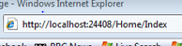
Invoked from Routing Engine
Controllers/Actions are URL-Addressable…
Routing engine parses URL: /home/index
Maps to corresponding controller and action method
Returns an “action result“
public class HomeController : Controller
{
public ActionResult Index()
{
ViewBag.Message = "Welcome!";
return View();
}
public ActionResult Retrieve(int id)
{
// Code that retrieves customer by id
return View(“Retrieve”, dataFile);
}
}
Both controller and action
are URL Addressable
Notes:
Estimated Time: 4 minutes
Talking Points:
Each controller/action method maps to a unique URI

Slide 81
Action Methods
Controller exposes 1 to many Action Methods
Operations that controller can perform
Each method corresponds to an operation
Each Action Method returns Action Result type
public class CustomerController : Controller
{
public ActionResult Index()
public ActionResult Get(int Id)
public ActionResult GetAll()
public ActionResult Add(Customer customer)
public ActionResult Edit(Customer customer)
public ActionResult Delete(Customer customer)
}
Notes:
Estimated Time: 4 minutes
Talking Points:

Slide 82
Action Result
Base type for variety of common return types
Action method returns required child action result
Derived Type | Behavior | Payload
ViewResult PartialViewResult | View engine prepares response | HTML
ContentResult | Renders raw content | String
FileContentResult | Returns file content | File
JsonResult | Renders data as Json | JSON
JavaScriptResult | Returns script to execute | JavaScript
RedirectResult | Redirects to another URL | Redirect
HttpNotFoundResult | Returns HTTP 404 status code | 404 Code
HttpUnauthorizedRequest | Returns HTTP 403 status code | 403 Code
EmptyResult | No response | Nothing

Slide 83
Action Methods and HTTP Verbs
Bind Action Method to HTTP verb (GET, POST, PUT, DELETE)
HTTP GET: Retrieves data only (read only)
HTTP POST: Submits data to server (changes state on server)
Expose different code blocks for same Action Method based on the HTTP operation
Each operation will have require different responsibilities
[HttpGet]
public ActionResult Create()
{
//…. Returns blank form for input (think of as read-only operation)
}
[HttpPost]
public ActionResult Create(Model model)
{
//…. Receives and processes submitted data
}
Notes:
Estimated Time: 4 minutes
Talking Points:

Slide 84
Chapter 2/Part 2 MVC Deep Dive VIEW MODEL
Notes:
http://www.publicdomainfiles.com/show_file.php?id=13548611416984

Slide 85
Injecting Models
Two approaches to injecting model, or data, file into view:
Controller
Data Class
View Model
Complete separation
Loose-coupling
Pass multiple entities and one-offs into single model
Keeps entities as POCO – no attributing
Each can change independently
More coding effort
Simple/Fast
Pass entity directly to view
Tightly couples view to entities
Inflexible: One-to-one mapping
Entity classes incur dependencies on validation and display attributes
View
Notes:
Estimated Time: 4 minutes
Talking Points:

Slide 86
Chapter 2/Part 2 MVC Deep Dive VIEW ENGINE
Notes:
http://www.publicdomainfiles.com/show_file.php?id=13548611416984

Slide 87
What is a View Engine?
Component that locates and parses a view template file, physically building output for the browser
Controller
specifies
view and
injects
model
Locates View
Locates Layout
Executes View
Injects
data with
markup
Returns HTML
Tasks Performed by the View Engine
Notes:
Estimated Time: 4 minutes
Talking Points:

Slide 88
Pluggable View Engines
View Engine is pluggable component in the MVC architecture
Web Forms
Engine
Razor
Web Forms
Engine
Spark
NHaml
NDJango
Web Forms
MVC
ASP.NET
.NET Framework
Notes:
Estimated Time: 4 minutes
Talking Points:

Slide 89
Chapter 2/Part 2 MVC Deep Dive RAZOR VIEW ENGINE
Notes:
http://www.publicdomainfiles.com/show_file.php?id=13548611416984

Slide 90
Razor View Engine
Preferred view engine since MVC 3
Short learning curve – not a new language
Leverage existing HTML and .NET language skills
Ditch the <%= %> all code starts with @
Full IntelliSense and compile-time checking
Intelligently detects transitions between HTML and Code
Notes:
Estimated Time: 2 minutes
Talking Points:

Slide 91
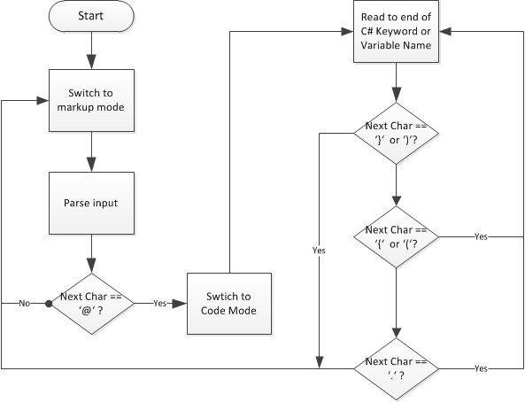
Razor
Parsing Algorithm
Notes:
Estimated Time: 2 minutes
Talking Points:

Slide 92
Comparing Expressions
<h1>ASPX Syntax</h1>
<h3>
Hello <%=name%>, they year is <%= DateTime.Now.Year %>
</h3>
<p>
Checkout <a href="/Products/Details/<%=productId%>">this product</a>
</p>
<h1>Razor Syntax</h1>
<h3>
Hello @name, they year is @DateTime.Now.Year
</h3>
<p>
Checkout <a href="/Products/Details/@productId">this product</a>
</p>
Notes:
Estimated Time: 2 minutes
Talking Points:

Slide 93
Comparing Looping Structures
<h1>ASPX Syntax</h1>
<ul id="products">
<% foreach (var p in products) {
%>
<li><%= p.Name%> ($<%=p.Price%>)</li>
<% } %>
</ul>
<h1>Razor Syntax</h1>
<ul id="products">
@foreach (var p in products)
{
<li>@p.Name ($@p.Price)</li>
}
</ul>
Notes:
Estimated Time: 2 minutes
Talking Points:

Slide 94
Razor Syntax – Simple Expression
Single token: A variable, property, method or collection element
‘@’ instructs Razor to switch to ‘code mode’, resolve the .NET API call and render dynamic text
No need to explicitly mark end of code – Razor infers it
<div> The @products.Count() products cost @products.Sum(x => x.Price) </div>
Notes:
Estimated Time: 2 minutes
Talking Points:

Slide 95
Razor Syntax – Complex Expression
Multiple tokens - wrap in parentheses: @(….)
@( - Switches Razor into code mode, resolves .NET code and renders dynamic text
Any valid .NET code statement within parentheses
) - Switches Razor back to mark-up mode
<div> My name is @(firstName + “ “ + MiddleName + “ “ + lastname)</div>
Notes:
Estimated Time: 2 minutes
Talking Points:

Slide 96
Razor Syntax – Code Block
Wrap code blocks within @{….}
@{ switches Razor into code mode and instructs it to execute code until it finds the closing brace - }
<text></text> -- Include mark-up inside code block
@{
var year = string.empty;
if (DateTime.Now.Year < 2000)
{
<text>Look out – Y2K is coming</text>
year = “Before 2000”;
}
else
{
<text> Wow, Y2k was a non-event </text>
year = “2000 or after”;
}
<div>@year</div>
}

Slide 97
Razor Syntax - Misc
Comments in Razor
@* comment *@ depicts a comment block for the Razor engine
Unlike HTML, Razor comments do not render to the browser source
Escaping the ‘@’ character
@@ tells Razor to escape the ‘@’ character, remain in mark-up mode and render an ‘@’ character
@* This is a comment in Razor syntax *@
<div>Escape the @ symbol with multiple @@ symbols</div>
Notes:
Estimated Time: 2 minutes
Talking Points:

Slide 98
Razor Syntax Highlights
Always think, one of three structures:
@ -- Simple expressions
@( … ) -- Complex expressions
@{ … } -- Code blocks
Remember:
@* … *@ -- Inline comments
@@ -- Escape the @ sign
<Text> … </Text> for mark-up within code block
Notes:
Estimated Time: 2 minutes
Talking Points:

Slide 99
Razor - Layouts
Acts as Master Page, but with compact syntax
Can define multiple, non-contiguous, replaceable regions within a layout file that you can then optionally “fill in” at runtime
<html>
<head>
<link href="@Url.Content("~/Content/Site.css")" rel="stylesheet" type="text/css" />
</head>
<body>
<div id="header"> @RenderSection("Header") </div>
<div id="menucontainer">
@Html.Partial("_LogOnPartial")
</div>
<div id="main"> @RenderBody() </div>
<div id="footer"> @RenderSection("Footer") </div>
</body>
</html>
Renders Header Section
Renders Partial View
Renders Containing View
Renders Footer Section
Notes:
Estimated Time: 2 minutes
Talking Points:

Slide 100
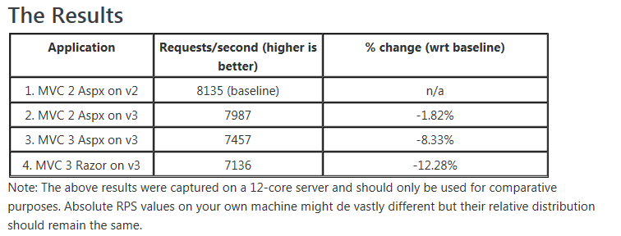
Razor
Performance
Razor engine appears to support performance increases over web form engine:
http://blogs.msdn.com/b/marcinon/archive/2011/01/17/mvc-3-performance.aspx
Notes:
Estimated Time: 2 minutes
Talking Points:

Slide 101
Chapter 2/Part 2 MVC Deep Dive HtmlHelpers
Notes:
http://www.publicdomainfiles.com/show_file.php?id=13548611416984

Slide 102

HTML?
Without Server Controls…
Server
Controls?
H
T
M
L
HTML Helpers?
Html
Helpers?
How do we generate HTML?

Slide 103
HTML Generation
MVC introduces Html Helpers
Extension methods that emit HTML markup
Unlike Server Controls, simple markup generator - no internal logic, lifecycle or state
Each supports numerous overloads to tailor usage
Html.BeginForm
Html.RenderAction
Html.RenderPartial
Html.ActionLink
Html.TextArea
Html.TextBox
Html.CheckBox
Html.DropDownList
Html.Hidden
Html.ListBox
Html.Password
Html.RadioButton
Notes:
Estimated Time: 5 minutes
Talking Points:

Slide 104
HTML Helper Flavors
String-Based Helpers
1st parameter: Name/Id
2nd parameter: Value
3rd parameter: Optional CSS style attribute
Strongly-Typed Helpers
Strongly typed – no “magic strings”
HTML Helper with a suffix of ‘For’ and a lambda statement
Enables compile-time checking and Intellisense
Both Render…
@Html.TextBox("FirstName", Model.FirstName, new { @class = “MyCoolColor " })
@Html.TextBoxFor(x => x.FirstName, new { @class = “MyCoolColor" })
input id=“FirstName” name=“FirstName” type=“text” value=“Rob” class=“MyCoolColor” />
Notes:
Estimated Time: 5 minutes
Talking Points:

Slide 105
Chapter 2/Part 2 MVC Deep Dive MODEL BINDING
Notes:
http://www.publicdomainfiles.com/show_file.php?id=13548611416984

Slide 106

Model Binding - HttpGet
URI Segments
GET request (via routing):
Map to URL Patterns
Port
Server
Port
Action
Controller
Id
routes.MapRoute(
"Default",
// Route name
"{controller}/{action}/{id}", // URL with parameters
new { controller = "Home", action = "Index", id = UrlParameter.Optional }
);
public class ProductsController : Controller{
public ActionResult Show(int id)
{
//.......
return View();
}
}
Map to controller, action
Notes:
Estimated Time: xx minutes
Talking Points:

Slide 107
Model Binding
Model Binder maps posted data to ActionMethod parameters
Eliminates need to access input data directly
Posted data arrives in ValueProvider property
Matches parameter and property names to those in incoming object
Binds primitives, complex types, collections
Model Binder logic can be extended
Form Data
Value Provider
Action parameters
Route Data
Query String
Notes:
Estimated Time: 4 minutes
Talking Points:

Slide 108
Input Data
Mvc packages input data into a simple dictionary container called the ValueProvider
The Controller ActionMethod can access any data sent inside the ValueProvider property
Form Data
Value
Provider
Route Data
Query String
Notes:
Estimated Time: 4 minutes
Talking Points:

Slide 109
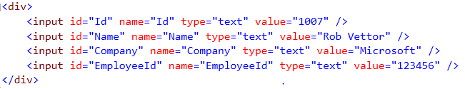



Model Binding - Manual
public class HomeController : Controller
{
public ActionResult Index(FormCollection formCollection)
{
int Id;
string name;
var employee = new EmployeeViewModel();
employee.Id = bool.TryParse(formCollection[“Id"], out Id);
employee.FirstName = string.IsNullOrEmpty(formCollection[“Name"])
? “Missing Name!" : formCollection[“Name"].ToString();
var result = employee.Repository.Add(employee);
return result );
}
}
Map raw values from
request to Action Method
Notes:
Estimated Time: xx minutes
Talking Points:

Slide 110
Model Binding - Better
public class HomeController : Controller
{
public ActionResult Index(int id, string name, string company, int employeeId)
{
var employee = new EmployeeViewModel();
employee.Id = id;
employee.FirstName = name;
employee.Company = company;
employee.EmployeeId = employeeId;
var result = employee.Repository.Add(employee);
return View(result);
}
}
Map primitive values
based on name.
Manually create and
populate employee
object
Notes:
Estimated Time: xx minutes
Talking Points:

Slide 111
Model Binding - Best
public class HomeController : Controller
{
public ActionResult Index(Employee employee)
{
var result = employee.Repository.Add(employee);
return View(result);
}
}
Instantiates and populates
employee object with
incoming request values
Notes:
Estimated Time: xx minutes
Talking Points:

Slide 112

Model Binding
The mechanism through which the controller receives input data from the browser
In Web Forms…
Process abstracted from developer
Server Controls automatically populate client input data from browser
ASP.NET runtime maps raw HTTP request data to properties on the sever control
protected void Page_Load(object sender, EventArgs e)
{
var customer = new Customer();
customer.Id = Request.QueryString["Id"];
customer.FirstName = txtFirstName.Text;
customer.LastName = txtLastName.Text;
customer.MaritalStatus = ddlMartialStatus.SelectedValue;
}
Notes:
Estimated Time: 4 minutes
Talking Points:

Slide 113
Chapter 2/Part 2 MVC Deep Dive VALIDATION
Notes:
http://www.publicdomainfiles.com/show_file.php?id=13548611416984

Slide 114
MVC Input Validation
Exposes built-in layer of declarative validation services
Leverage without writing any code
Centralize by decorating model with validation attributes…
Validation code automatically generated…
Both client- and server-side…
Built-in remote validation plumbing
Extensible – “roll your own” custom validation services
Server
Validation
Client Validation
Remote Validation
Custom
Validation
Notes:
Estimated Time: 5 minutes
Talking Points:

Slide 115
Validation by Annotation
Add by applying built-in validation attributes to model properties
public class StudentViewViewModel
{
[Required(ErrorMessage = "First Name is required.")]
[Display(Name = “Student First Name")]
[MinLength(2, ErrorMessage = "First name must be at least 2 characters")]
[MaxLength(35, ErrorMessage = "First name cannot exceed 35 characters")]
public string FirstName { get; set; }
}
Notes:
Estimated Time: 4 minutes
Talking Points:

Slide 116
Built-In Validation Types
Large number of validation types are built into MVC framework:
Attribute | Description
Required | Makes data item required
Display | Applies friendly name to labes
Min/Max Length | Applies max/min length to data
DisplayFormat | Applies DataFormatString to data
RegularExpression | Applies regular expression to data
DataType | Applies specific data type to data
ReadOnly | Makes data item read-only
Notes:
Estimated Time: 4 minutes
Talking Points:

Slide 117
Client-Side Validation
Automatically generated for you
Implements Unobtrusive JavaScript
JavaScript not emitted into HTML
Leverages JQuery validation files
HTML smaller and less cluttered
By default, validation helpers in MVC use jQueryValidate plugin
Configured in Web.Config file…
<appSettings>
<add key="ClientValidationEnabled" value="true"/>
<add key="UnobtrusiveJavaScriptEnabled" value="true"/>
</appSettings>
Notes:
Estimated Time: 1 minute
Talking Points:
Client-Side Validation Enabled by Default
In earlier versions of MVC, you need to explicitly call the Html.EnableClientValidation method from a view in order to enable client-side validation. In MVC 3 this is no longer required because client-side validation is enabled by default. (You can disable this using a setting in the web.config file.)
In order for client-side validation to work, you still need to reference the appropriate jQuery and jQuery Validation libraries in your site. You can host those libraries on your own server or reference them from a content delivery network (CDN) like the CDNs from Microsoft or Google.
JavaScript and Ajax Improvements
By default, Ajax and validation helpers in MVC 3 use an unobtrusive JavaScript approach. Unobtrusive JavaScript avoids injecting inline JavaScript into HTML. This makes your HTML smaller and less cluttered, and makes it easier to swap out or customize JavaScript libraries. Validation helpers in MVC 3 also use the jQueryValidate plugin by default. If you want MVC 2 behavior, you can disable unobtrusive JavaScript using a web.config file setting. For more information about JavaScript and Ajax improvements, see the following resources:
Basic introduction to unobtrusive JavaScript on the Wikipedia site
Brad Wilson's Unobtrusive JavaScript Post
Brad Wilson's Unobtrusive JavaScript Validation Post
Creating a MVC 3 Application with Razor and Unobtrusive JavaScript (tutorial on the ASP.NET site)
MVC 3 Release Notes

Slide 118
Remote Validation
Some validation impractical from client side…
Example: Database lookup
MVC 3 supports new feature: Remote Validation
Leverages jQuery plug-in
Automatically implements server side validation with Ajax service calls
Returns JSON result
[Remote(”LookUpUserName” , ErrorMessage=”Invalid User Name” )]
public string UserName { get; set; }
Notes:
Estimated Time: 2 minutes
Talking Points:
Remote Validation
ASP.NET MVC 3 supports the new RemoteAttribute class that enables you to take advantage of the jQuery Validation plug-in's remote validator support. This enables the client-side validation library to automatically call a custom method that you define on the server in order to perform validation logic that can only be done server-side.

Slide 119
Chapter 2/Part 2 MVC Deep Dive FILTERS
Notes:
http://www.publicdomainfiles.com/show_file.php?id=13548611416984

Slide 120
Filters
Additional behavior, built-in or custom, that attach to controllers or action methods that declaratively extend functionality without changing code…
Authorization Filters
Make security decisions before executing action method code
Action Filters
Invoked before/after action method code execution
Inspect operation allowing for conditional or additional processing
Result Filters
Invoked before/after action result code execution
Inspect return values, cancel operation or perform additional processing
Action Selectors
Selects the action method that will be invoked
Exception Filters
Executes when unhandled exception is raised
Great for implementing logging and rendering a custom error view

Slide 121
Authorization Filters
Built-in attribute – attach to controller or action method
Restricts access to only authenticated users
Redirects unauthenticated users to a logon page
Optionally restrict access to users in specific role
[Authorize(Roles=“Admin”)]
User must be authenticated and member of Admin role
[Authorize]
public ActionResult Create() {…}
<authentication mode="Forms">
<forms loginUrl="~/Account/LogOn" timeout="2880" />
</authentication>

Slide 122
More Built-In Filters
Extend infrastructure plumbing
[HandleError(ExceptionType = typeof(NullReferenceException), View = "NullError")]
[HandleError(ExceptionType = typeof(SecurityException), View = "SecurityError")]
public class HomeController : Controller
{
[OutputCache(Duration = 15)]
public ActionResult Index()
{
ViewData["Message"] = DateTime.Now;
return View();
}
[Authorize(Roles="Admin, SalesReps")]
public ActionResult About()
{
return View();
}
}
HandleError Filter
Redirect to custom error views
OutputCache Filter
Caches action results
Authorize Filter
Restrict Access
Notes:
Estimated Time: 5 minutes
Talking Points:

Slide 123
Custom Action Filters
Add pre-/post-action behavior to controller actions/results
Extend and manipulate behavior
Ideal for implementing cross-cutting functionality
public class LogMessageAttribute : ActionFilterAttribute
{
public string Message { get; set; }
public override void OnActionExecuting(ActionExecutingContext filterContext)
{ … }
public override void OnActionExecuted(ActionExecutedContext filterContext)
{ … }
public override void OnResultExecuting(ResultExecutingContext filterContext)
{ … }
public override void OnResultExecuted(ResultExecutedContext filterContext)
{ … }
}
Fires before action
Fires after action
Fires before result
Fires after result
[LogMessage(Message = "Hello from Microsoft")]
public class ArticleController : Controller

Slide 124
Action Selectors
Filter that select action method to handle an operation
HTTP Accept Verbs
Expose different code blocks for same action method selected by the HTTP operation
HTTP GET: Retrieves data only (read only)
HTTP POST: Submits data to server (changes state on server)
[HttpGet]
public ActionResult Create()
{
//…. Returns blank form for input (think of as read-only operation)
}
[HttpPost]
public ActionResult Create(Model model)
{
//…. Receives and processes submitted data
}
Action method invoked
for Get operation
Action method invoked
for Post operation
Notes:
Estimated Time: 4 minutes
Talking Points:

Slide 125
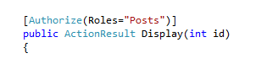
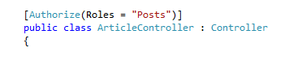
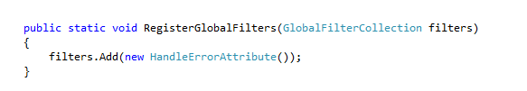
Filter Scope…
Single Action Method:
Entire Controller
Entire Application - Global filter

Slide 126
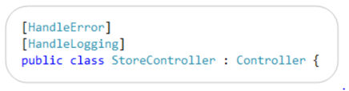
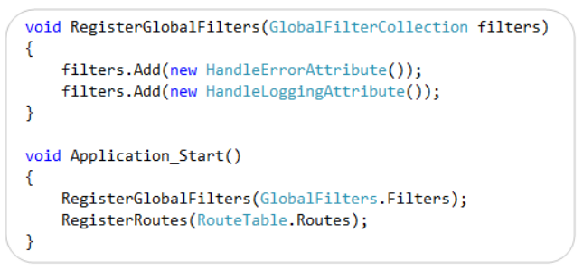
Global Filters
Global filter executes on every action request
RegisterGlobalFilters() method exposed in global.asax
Notes:
Sometimes you want to perform logic either before an action method runs or after an action method runs. To support this, ASP.NET MVC 2 provided action filters. Action filters are custom attributes that provide a declarative means to add pre-action and post-action behavior to specific controller action methods. However, in some cases you might want to specify pre-action or post-action behavior that applies to all action methods. MVC 3 lets you specify global filters by adding them to the GlobalFilters collection. For more information about global action filters, see the following resources:
Scott Guthrie's blog on the MVC 3 Preview
Filtering in ASP.NET MVC

Slide 127
Custom Action Filters
Create to extend and manipulate behavior
Derive from ActionFilterAttribute
Excellent from implementing cross-cutting functionality
Logging,
Caching,
Monitoring,
Transactions,
Security
public class LogMessageAttribute : ActionFilterAttribute
{
public string Message { get; set; }
public override void OnActionExecuting(ActionExecutingContext filterContext)
{ … }
public override void OnActionExecuted(ActionExecutedContext filterContext)
{ … }
public override void OnResultExecuting(ResultExecutingContext filterContext)
{ … }
public override void OnResultExecuted(ResultExecutedContext filterContext)
{ … }
}
[LogMessage(Message = "Hello from Microsoft")]
public class ArticleController : Controller
{
// Body of the controller
}

Slide 128
Chapter 2/Part 2 MVC Deep Dive DEPLOYMENT
Notes:
http://www.publicdomainfiles.com/show_file.php?id=13548611416984

Slide 129
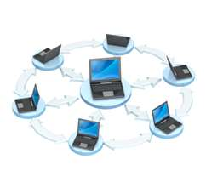
MVC Deployment
Three approaches to deploy MVC Applications to IIS
Xcopy files
Deployment Package
One-Click Publishing
All approaches achieve the same result
Degree of automation varies
Two of the approaches support web.config transformations
Automatically control web.config settings based upon the target environment
Disable debug options
Change connection strings

Slide 130

Xcopy Deployment
Most basic approach
Manually copy required files:
The compiled .NET assemblies (/bin folder)
Configuration files (web.config and global.asax)
View files (.cshtml)
Static files (images, CSS, JavaScript files)
For security reasons, best not to copy:
C# code files
Project files

Slide 131

Deployment Package
Visual Studio can generate deployment package
Zip file containing application files along with supporting configuration files
Supports web.config transformations
Supports database deployment
IIS Manager supports Import Package wizard
Deployment steps are presented
Option to prevent individual items from being deployed
Option to override database connection string settings
Must install Web Deployment features on server

Slide 132

One-Click Publishing
Connect to server and deploy application directly without copying files
Configure and launch One-Click publisher from Visual Studio
Select the publication method:
WebDeploy
FTP
File System
FPSE
Supports web.config transformations
Supports database deployment
Zip file containing the application files along with supporting configuration files
Supports web.config transformations
Supports database deployment
IIS Manager supports Import Package wizard
Deployment steps are presented
Option to prevent individual items from being deployed
Option to override database connection string settings
Must install Web Deployment features on server

Slide 133
Chapter 2/Part 2 MVC Deep Dive RAZOR LAYOUTS
Notes:
http://www.publicdomainfiles.com/show_file.php?id=13548611416984

Slide 134
Razor - Layouts
Acts as Master Page, but with compact syntax
Can define multiple, non-contiguous, replaceable regions within layout and optionally “fill in” at runtime
Notes:
Estimated Time: 2 minutes
Talking Points:

Slide 135
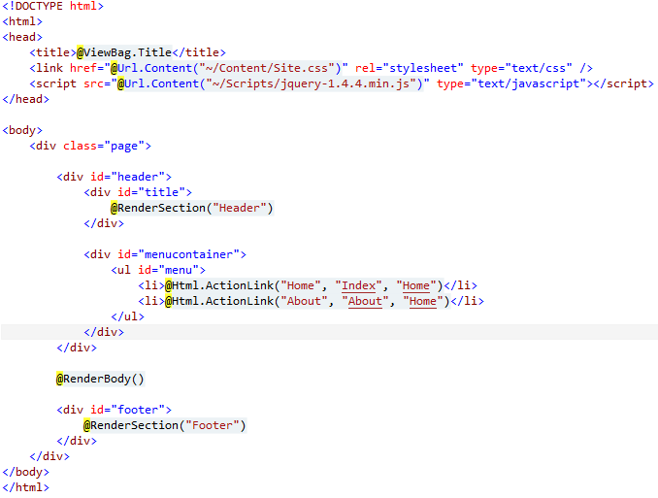
Razor - Layouts
Renders
Header Section
Consider
Partial Class
Renders containing page
Renders
Footer Section
Notes:
Estimated Time: 2 minutes
Talking Points:

Slide 136
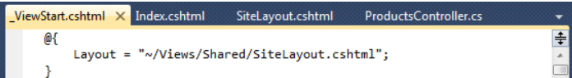
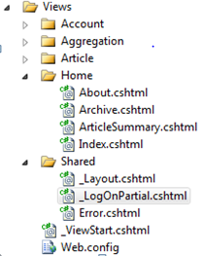
Razor Supporting Files
Each Razor view starts by firing _ViewStart.cshtml
Container to specify code to include in all views
Razor calls first, by convention, each time it creates a view
Supports DRY principle: Shared code in one place
Razor supports shared subfolder within view folder
Contains common partial views shared across all views
By convention, partial views start with underscore
When searching for a view, Razor will search controller view folder and then the shared directory
Notes:
Estimated Time: 2 minutes
Talking Points:

Slide 137

MIND…
BLOWN!

Slide 138

Don’t Get Too Excited!
Notes:
Ignorance is bliss?

Slide 139

What Requirements?
Notes:
.NET Core! True Cross Platform .NET!

Slide 140

Don’t Get Too Excited!
Notes:
Ignorance is bliss?

Slide 141

Tunnel Vision

Slide 142
Agenda/Goals
Chapter 1 – ASP.NET
Chapter 2 – MVC
Chapter 3 - .NET MVC Core
Chapter 4 – Razor Pages
Available Resources
Notes:
The wrong way!

Slide 143
Chapter 3 .NET Core MVC
Notes:
http://www.publicdomainfiles.com/show_file.php?id=13548611416984

Slide 144
Pop Quiz: What did Microsoft release in beta in 2006?
.NET 3.0

Slide 145
Pop Quiz: What were the four components of .NET 3.0?
1. WCF
2. WPF
3. WF
4. Cards?

Slide 146

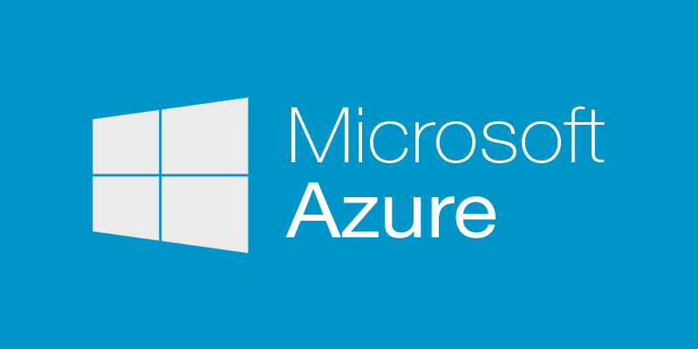

ALL the WAY Back to the Core!

Slide 147

What’s at the CORE?
Notes:
.NET Core! True Cross Platform .NET!

Slide 148
Into The Core
Notes:
.NET Core! True Cross Platform .NET!

Slide 149
.NET Core
Notes:
.NET Core! True Cross Platform .NET!

Slide 150
Cross-platform Open source Flexible Modular
.NET Core
Notes:
iOS, Linux, Xamarin,

Slide 151
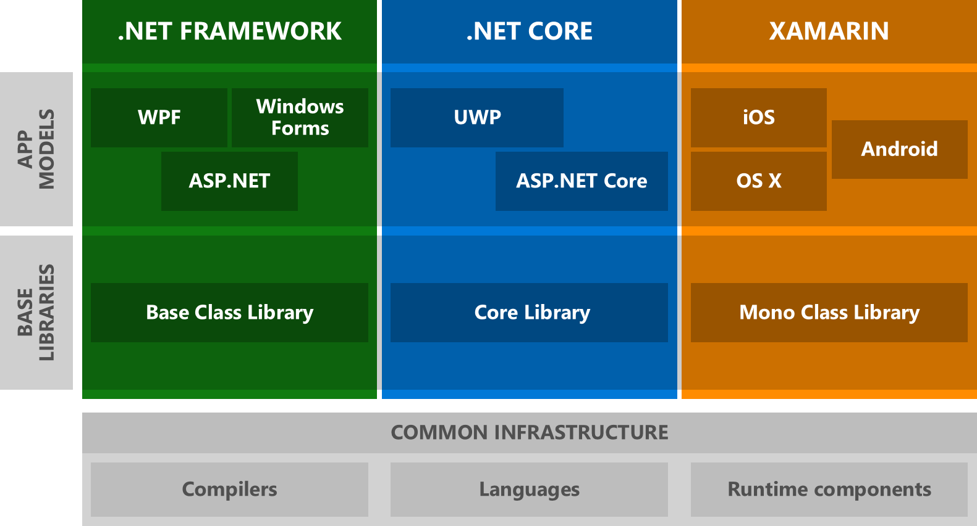
.NET Today
Notes:
So you don’t have to do it again!

Slide 152
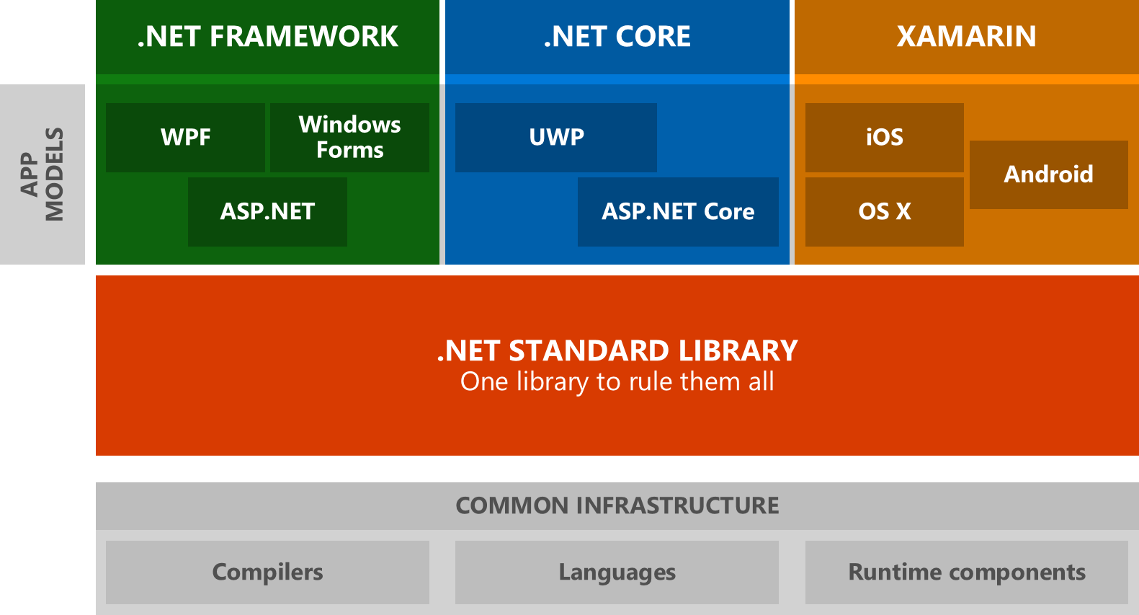
.NET Tomorrow
Notes:
So you don’t have to do it again!

Slide 153
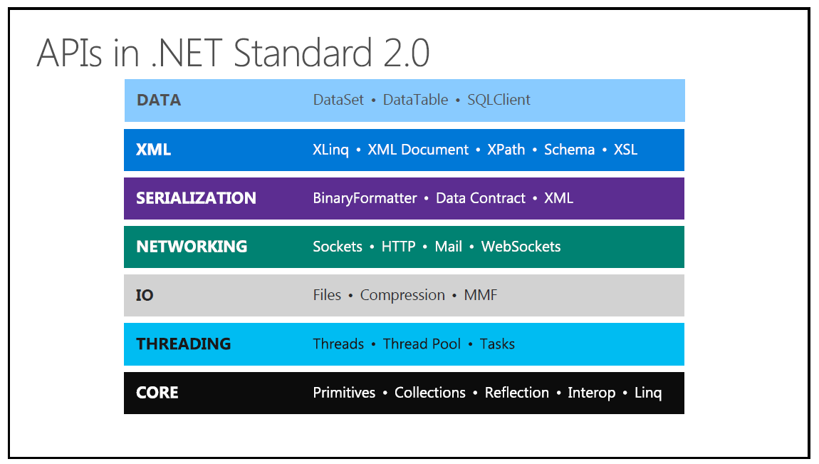

Slide 154
Underlying Web Architecture
ASP.NET Core
Caching
Modules
Globalization
Pages
Controls
Master Pages
Profile
Roles
Membership
Intrinsics
Handlers
Etc.

Slide 155
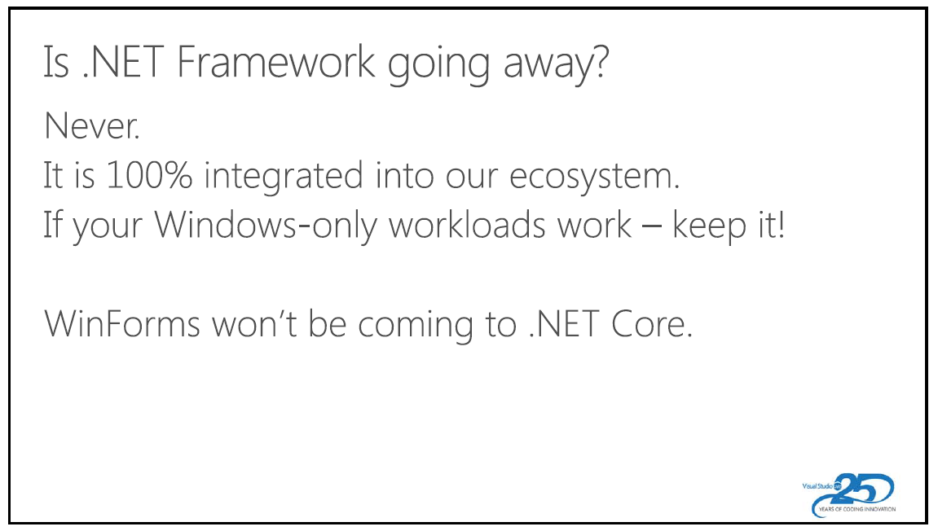

Slide 156
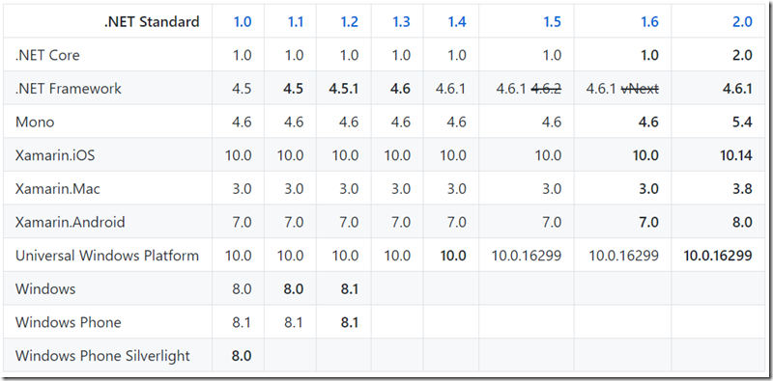
.NET Standard
Notes:
So you don’t have to do it again!

Slide 157
.NET Core 2.1 Preview
Just Released 2/27/2018
Faster Build Performance
Close gaps in ASP.NET Core and EF Core
Improve compatibility with .NET Framework
GDPR and Security
Microservices and Azure
More capable Engineering System
New HttpClientHandler and SocketHttpHandler
Span<T> and Memory<T> no more “Array Copy”
Notes:
So you don’t have to do it again!

Slide 158
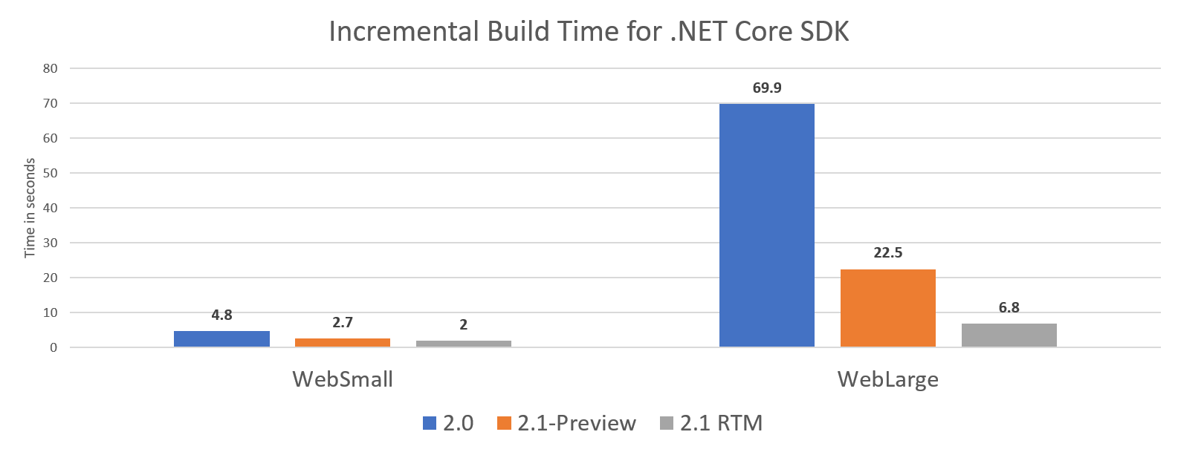
.NET Core 2.1 Preview
Notes:
So you don’t have to do it again!

Slide 159
.NET Core 2.1 Preview
Platform Support:
Windows Client: 7, 8.1, 10 (1607+)
Windows Server: 2008 R2 SP1+
macOS: 10.12+
RHEL: 7+
Fedora: 26+
openSUSE: 42.3+
Debian: 8+
Ubuntu: 14.04, 16.04, 17.10+
SLES: 12+
Alpine: 3.6+
Notes:
So you don’t have to do it again!

Slide 160
EF Core 2.1 Preview
New Features:
Lazy Loading
Parameters in entity constructors
Value conversions
LINQ GroupBy translation to the SQL GroupBY
Data Seeding
Query types – No Primary Keys?!
Include for derived types
System.Transactions support
Better column ordering in initial migration
Optimization of correlated subqueries
Owned Attribute
Notes:
So you don’t have to do it again!

Slide 161
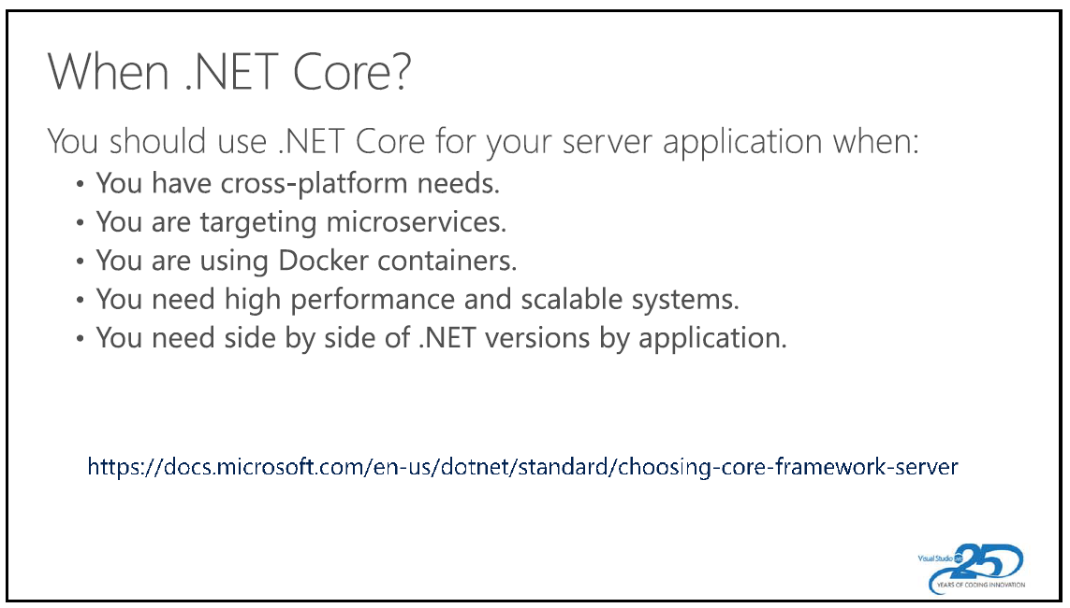

Slide 162
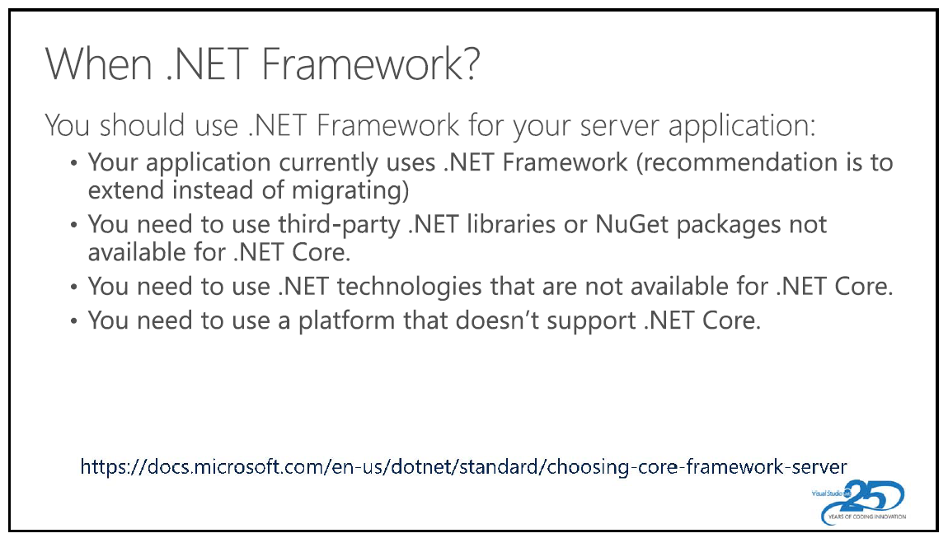

Slide 163
Do it Right
Notes:
So you don’t have to do it again!

Slide 164
The First Time
Notes:
It saves so much time and effort!

Slide 165
Example: Sitecore.SharedSource.ListRenderer
GetSitecoreContent
GetWebContent
GetDbContent
Notes:
The wrong way!

Slide 166
IInterface
Notes:
I Interface… ALWAYS INTERFACE!

Slide 167
Example: Sitecore.SharedSource.ListRenderer
IDataSource
Notes:
FileSystem/Storage, etc., etc.

Slide 168
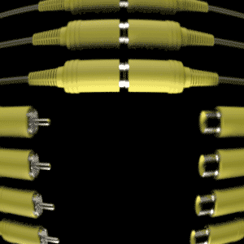
IDataSource
Notes:
FileSystem/Storage, etc., etc.

Slide 169
Agenda/Goals
Chapter 1 – ASP.NET
Chapter 2 – MVC
Chapter 3 - .NET MVC Core
Chapter 4 – Razor Pages
Resources
Notes:
The wrong way!

Slide 170
Chapter 4 Razor Pages
Notes:
http://www.publicdomainfiles.com/show_file.php?id=13548611416984

Slide 171
Razor Pages != Razor Syntax
“Razor Pages is an exciting new product released with ASP.NET Core 2, which makes building webpages without an MVC framework quick and easy. You can use it alone or in combination with ASP.NET MVC. In this course with Microsoft MVP ….”

Slide 172
Your Code
Startup.cs
Program.cs
Configuration/Manage User Secrets
EFCore
Middleware/Services

Slide 173

Razor Pages versus .NET Core MVC
Notes:
http://www.publicdomainfiles.com/show_file.php?id=13548611416984

Slide 174
Pop Quiz: What is Azure?
Microsoft’s Cloud Computing Platform and Infrastructure

Slide 175
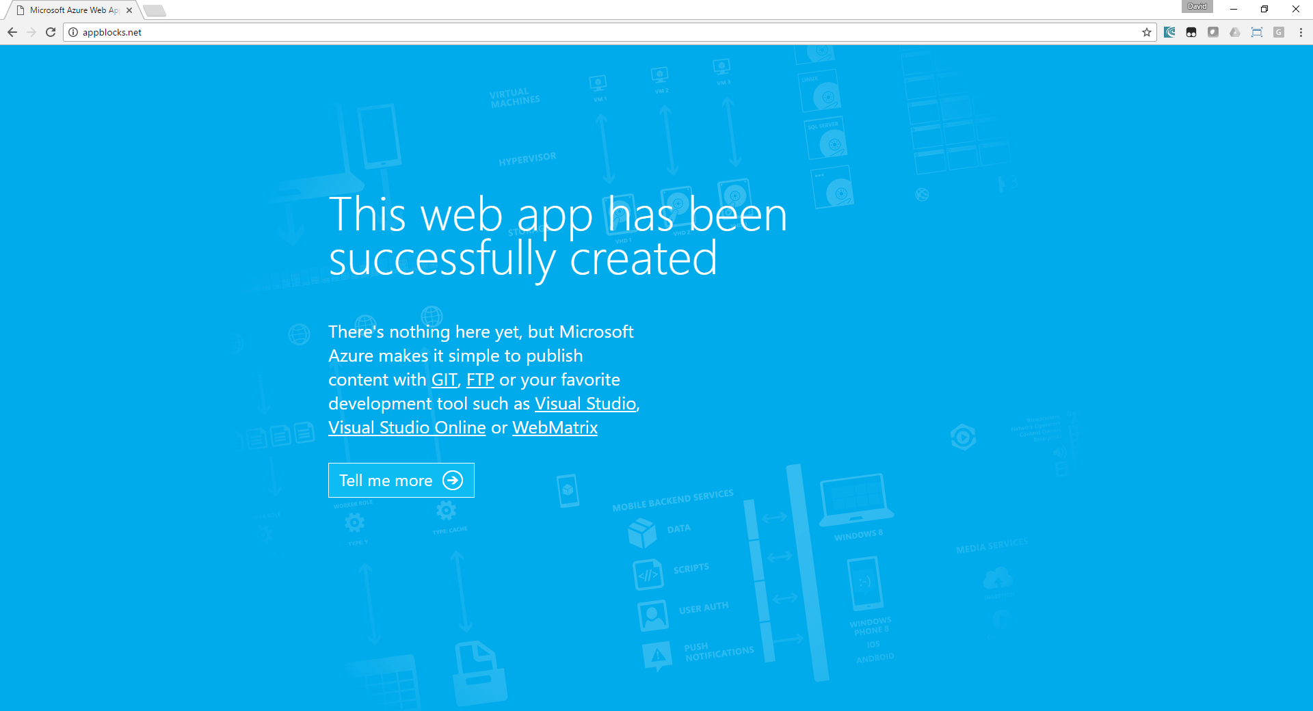
demo

Slide 176
Agenda/Goals
Chapter 1 – ASP.NET
Chapter 2 – MVC
Chapter 3 - .NET MVC Core
Chapter 4 – Razor Pages
Resources
Notes:
The wrong way!

Slide 177
Saving you some headaches…
Notes:
With simple Provider style organization, you can exponentially Accelerate the Business Experience

Slide 178
Questions & Ideas?

Slide 179
Want More?

Slide 180
Get Social

Slide 181
Learn Together

Slide 182
Resources
http://MicrosoftVirtualAcademy.com
http://GitHub.com/dotnet
http://GitHub.com/dotnet/core
http://GitHub.com/dotnet/standard
http://GitHub.com/SitecoreDave/
Connect with me:
Twitter: @DavidWalker, LinkedIn, Facebook, http://RadicalDave.com
Notes:
The wrong way!

Slide 183
Other Sessions @ KCDC
Which Microsoft Framework Am I Supposed to Use?
Chad Green
For 15 years, the biggest decision was whether it was time to upgrade to the latest .NET framework or not. Now there is the .NET Framework, .NET Core, and .NET Standard. So many options and it not completely obvious which one (or ones) you should be using. During this session, you see a down to earth description of what each of these are and get an idea of when you should be one or more of these and what version of them based upon what you are building or maintaining.
Room: 2201 Time: 07/12 08:45 Session : .NET

Slide 184
Other Sessions @ KCDC
Versioning and Maintaining Your REST API in ASP.NET Core
Spencer Schneidenbach
When tasked with making a REST API for your system, you'll inevitably have to think about versioning. One of the most difficult parts of API maintenance, versioning is an essential conversation to have about the future of your API, even before you hit File -> New Project. Do you version in the URL (v1/api/whatever)? Do you use header versioning? Should I update my production API in place? In this session, Spencer will provide several strategies and real world examples of API versioning done right... and wrong. We'll discuss versioning strategies such as header versioning and URL versioning, as well as best practices on how to intelligently version your REST API without tearing your hair out... or making your consumers tear their hair out.
Room: 2201 Time: 07/12 10:00 Session : .NET

Slide 185
Other Sessions @ KCDC
.NET Development Yesterday, Today and Tomorrow
Javier Lozano
Trying to make sense of .NET Core and .NET Standard? Looking for ways to reuse your current .NET Framework code? In this session we will cover how you can take your existing .NET Framework code and reuse it in your .NET Standard/Core applications with ease.
Room: 2215 A Time: 07/12 10:00 Session : .NET

Slide 186
Other Sessions @ KCDC
Goodbye REST APIs. Hello GraphQL!
Cory House
GraphQL has quickly matured into a compelling alternative to traditional REST APIs. But what's all the buzz about? In this session we’ll dissect what makes GraphQL special. You'll see how GraphQL integrates nicely with variety popular technologies like React, Angular, Vue and more. And you’ll learn how to easily migrate your existing RESTful APIs to GraphQL by wrapping your existing services.
Room: 2215 C Time: 07/12 11:15 Session : JavaScript

Slide 187
Other Sessions @ KCDC
The Pragmatic Guide to Web Application Security
Dustin Ewers
As a developer, your customers expect a constant stream of shiny new features. While it's important to deliver business value, there's more to building a web application. Keeping your apps secure is vital to the health of your company. It seems like there's a new story every week of a company that failed to secure their data. A security breach resulting from your faulty code is the ultimate career limiting move. Your beautiful application isn't much use if it can get hacked by a bored teenager. In this talk, you'll learn how to secure modern web applications. You'll about how to examine the data flows of your app to find security flaws before you write a single line of code. You'll learn how to attack your own web app to find security vulnerabilities. Finally, you will also learn how to secure the different layers of your application against common attacks. By the end of this talk, you will be well on your way to keeping the bad guys out of our app.
Room: 2201 Time: 07/12 11:15 Session : .NET

Slide 188
Other Sessions @ KCDC
Deconstructing and Evolving REST Security
David Blevins
The learning curve for security is severe and unforgiving. Specifications promise infinite flexibility, habitually give old concepts new names, are riddled with extensions, and almost seem designed to deliberately confuse. For a back-end REST developer, choking all this down for the first time is mission impossible. With an aggressive distaste for fancy terminology, this session delves into OAuth 2.0 as it pertains to REST and shows how it falls into two camps: stateful and stateless. We then detail a competing Amazon-style approach called HTTP Signatures, ideal for B2B scenarios and similar to what is use to secure all Amazon AWS API calls. Each approach will be explored analyzing the architectural differences, with a heavy focus on the wire, showing actual HTTP messages and enough detail to have you thinking, “I could write this myself.” As a bonus at the end, we’ll peak into a new IETF Internet Draft launched this year that combines JWT and HTTP Signatures into the perfect two-factor system that could provide a one-stop shop for business as well as mobile REST scenarios. Come to this session if you want to go from novice to expert with a bit of humor, a big picture perspective and wire-level detail.
Room: 2204 Time: 07/12 11:15 Session : Cloud

Slide 189
Other Sessions @ KCDC
Entity Framework performance monitoring and tuning
Jim Wooley
Object Relational Mapping technologies, including the Entity Framework can drastically simplify the programming model against databases, but when done carelessly, performance can suffer. In this session, we'll explore some real-life strategies that have solved performance issues in production applications that I have encountered at a variety of customers. We'll discuss the pros and cons of working without stored procs and cover strategies for monitoring and tuning your entity queries.
Room: 2215 A Time: 07/12 13:15 Session : .NET

Slide 190
Other Sessions @ KCDC
Building Reusable UI Components in ASP.NET Core
Scott Addie
ASP.NET 4.x MVC developers have long relied upon partial views and HTML helpers to construct reusable UI components. ASP.NET Core expands upon the arsenal of options for creating such UI components by introducing view components and Tag Helpers. Do these new offerings render partial views and HTML helpers obsolete? Absolutely not! Using the right tool for the job is important, which means understanding the differences between these options is paramount. In this session, you'll gain an understanding of when it's most appropriate to use each of them in the real world. You'll also see how to create basic view components and Tag Helpers.
Room: 2215 A Time: 07/13 08:30 Session : .NET

Slide 191
Other Sessions @ KCDC
Custom Middleware & Microservices with ASP.NET Core
Ondrej Balas
At the core of ASP.NET Core is Microsoft’s implementation of the OWIN standard, giving developers full control over the ASP.NET pipeline. In this session I will explain what OWIN is and how it can empower you to quickly and easily reconfigure an entire web application. Now in full control, you can do everything from injecting custom code (middleware) into any stage of the pipeline to running lightweight applications and microservices without MVC.
Room: 2215 A Time: 07/13 11:00 Session : .NET

Slide 192
TITANIUM SPONSORS
Platinum Sponsors
Gold Sponsors

